Slide 1
HTML canvas
Made by: Muniba Javaid

Slide 2
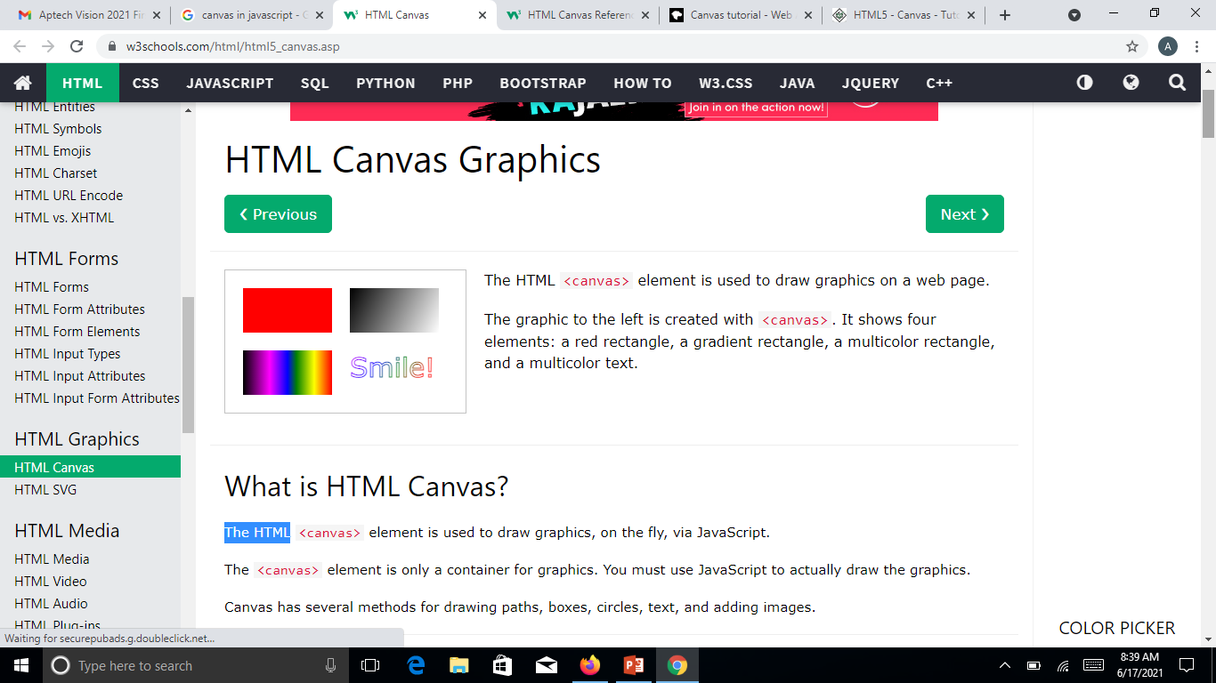
What is canvas
HTML5 element <canvas> gives you an easy and powerful way to draw graphics using JavaScript.
It can be used to draw graphs, make photo compositions or do simple (and not so simple) animations.
The latest versions of Firefox, Safari, Chrome and Opera all support for HTML5 Canvas but IE8 does not support canvas natively.

Slide 3
Example 1
<style>
#mycanvas{
border:1px solid red;
width: 100%;
height: 100%;
}
</style>
<body>
<canvas id = "mycanvas" ></canvas>
</body>

Slide 4
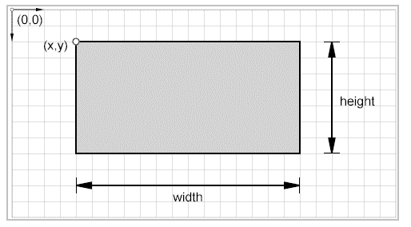
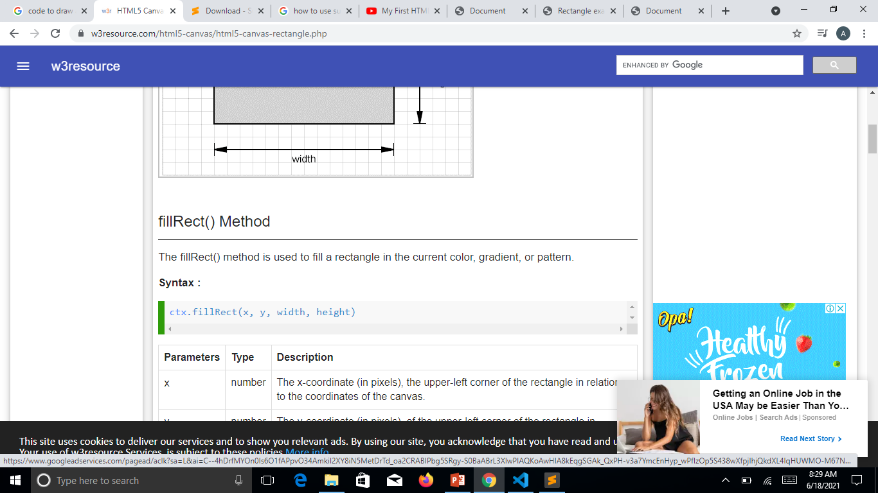
Draw Rectangles
To draw a rectangle, specify the x and y coordinates (upper-left corner) and the height and width of the rectangle.

Slide 5
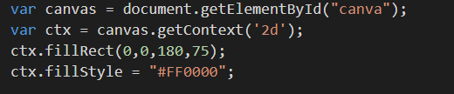
SIMPLE RECTANGULAR

Slide 6
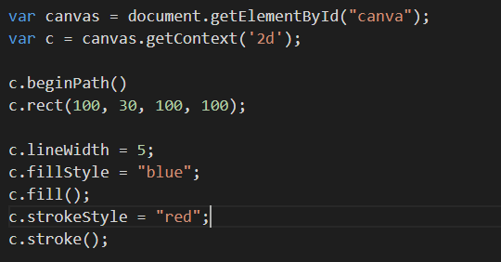
RECTANGULAR with STYLE

Slide 7
Draw lines
To draw a line using HTML5 Canvas is simple, just like draw a line on a paper, define a path, and then fill the path. See the following steps :
Resets the current path using beginPath() method.
Let move the drawing cursor to start point to create a new subpath using moveTo(x,y) method.
Now use lineTo(x, y) method, which adds a new point and connects this point to the starting point by using a straight line.
Both the above methods accept x and y parameters which tell it exactly where you want to draw the line.
Finally use stroke() method to make the line visible.

Slide 8
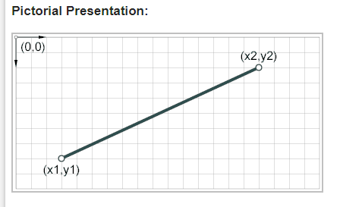
Cont.…

Slide 9
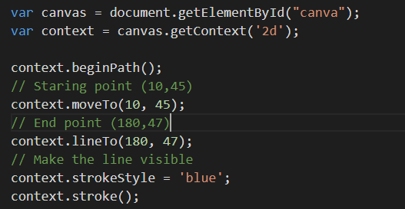
LINE EXAMPLE 1

Slide 10
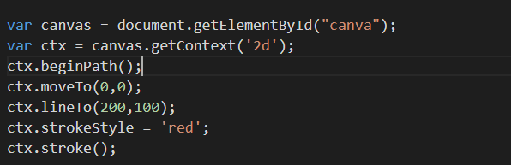
LINE EXAMPLE 2

Slide 11
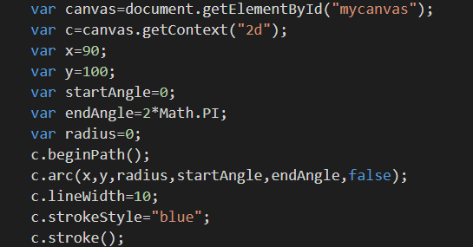
Draw circle (EXAMPLE 1)

Slide 12
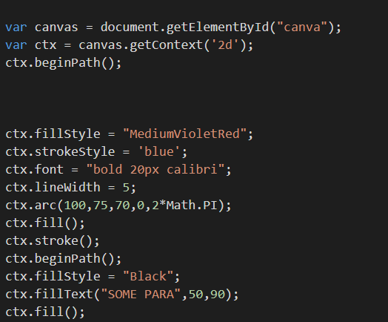
circle (EXAMPLE 2) WITH TEXT

Slide 13
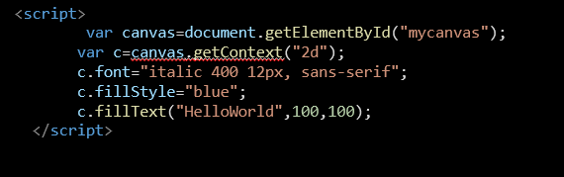
SIMPLE TEXT INSERT IN CANVA

Slide 14
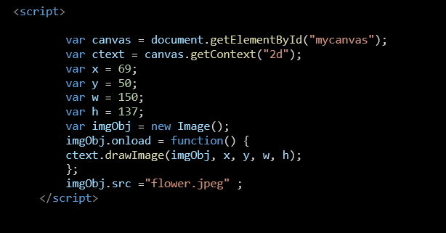
INSERT image Using Canva

